Slide 1
Using Machine Learning to Find Locations for Opening of New Asian Restaurant
By- Abhishek Shelke

Slide 2
BACKGROUND
For this Capstone project, I will be creating a hypothetical scenario for a concept Asian Cuisine restaurateur who wants to explore opening an authentic Indian restaurant in Toronto area. The idea behind this project is that there may not be enough Indian restaurants in Toronto, and it might present a great opportunity for this entrepreneur who is based in Canada. As Indian food is very similar to other Asian cuisines, this entrepreneur is thinking of opening this restaurant in locations where Asian food is popular (aka many Asian restaurants in the neighborhood). With the purpose in mind, finding the location to open such a restaurant is one of the most important decisions for this entrepreneur and I will be designing this project to help him find the most suitable location for his new opening.

Slide 3
BUSINESS PROBLEM
The objective of this capstone project is to find the most suitable location for entrepreneur to open a new Indian restaurant in Toronto, Canada. By using data science methods and machine learning methods such as clustering, this project aims to provide solutions to answer the business question: -
In Toronto, if an entrepreneur wants to open an Indian restaurant, where should they consider opening it?
TARGET AUDIENCE
Any entrepreneur who wants to find the location to open authentic Indian restaurant in Toronto.
This model can also be used for any entrepreneur who wants to open a new restaurant in Toronto with less knowledge of the city.

Slide 4
DATA
To solve this problem, I will need below data:
● List of neighborhoods in Toronto, Canada.
● Latitude and Longitude of these neighborhoods.
● Venue data related to Asian restaurants. This will help us find the neighborhoods that are most suitable to open an Indian restaurant.
EXTRACTING DATA
● Scrapping of Toronto neighborhoods via Wikipedia
● Getting Latitude and Longitude data of these neighborhoods via Geocoder package
● Using Foursquare API to get venue data related to these neighborhoods

Slide 5
METHODOLOGY
First, I need to get the list of neighborhoods in Toronto, Canada. This is possible by extracting the list of neighborhoods from Wikipedia page -
(“https://en.wikipedia.org/wiki/List_of_postal_codes_of_Canada:_M ”)
I did the web scraping by utilizing pandas html table scraping method as it is easier and more convenient to pull tabular data directly from a web page into data frame. However, it is only a list of neighborhood names and postal codes. I will need to get their coordinates to utilize Foursquare to pull the list of venues near these neighborhoods. To get the coordinates, I tried using Geocoder package, but it was not working so I used the csv file provided by IBM team to match the coordinates of Toronto neighborhoods. After gathering all these coordinates, I visualized the map of Toronto using Folium package to verify whether these are correct coordinates. Next, I use Foursquare API to pull the list of top 100 venues within 500 meters radius. Lastly, I performed the clustering method by using k-means clustering. K-means clustering algorithm identifies k number of centroids, and then allocates every data point to the nearest cluster, while keeping the centroids as small as possible. It is one of the simplest and popular unsupervised machine learning algorithms and it is highly suited for this project as well. I have clustered the neighborhoods in Toronto into 3 clusters based on their frequency of occurrence for “Thai food”. Based on the results (the concentration of clusters), I will be able to recommend the ideal location to open the restaurant.

Slide 6
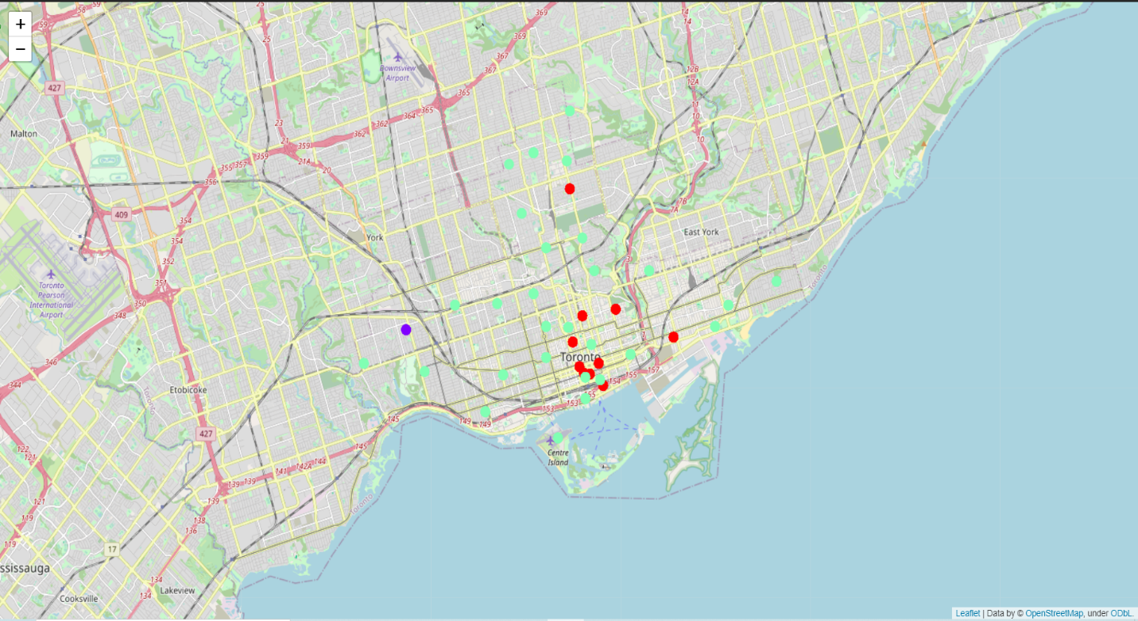
CLUSTERS

Slide 7
RESULT
The results from k-means clustering show that we can categorize Toronto neighborhoods into 3 clusters based on how many Thai restaurants are in each neighborhood:
● Cluster 0: Neighborhoods with little or no Thai restaurants
● Cluster 1: Neighborhoods with no Thai restaurants
● Cluster 2: Neighborhoods with high number of Thai restaurants
The results are visualized in the above map with Cluster 0 in red color, Cluster 1 in purple color and Cluster 2 in light green color.

Slide 8
CONCLUSION
In this project, we have gone through the process of identifying the business problem, specifying the data required, extracting and preparing the data, performing the machine learning by utilizing k-means clustering and providing recommendation to the stakeholder.
REFERENCES
List of neighborhoods in Toronto: https://en.wikipedia.org/wiki/List_of_postal_codes_of_Canada:_M Foursquare
Developer Documentation: https://developer.foursquare.com/docs

Slide 9
THANK YOU

